Slide 1
Phase 0 Example Responses
Flight School 2020

Slide 2
Agenda
Discovery Questions
Trip Report
As-Is and To-Be Architecture Diagrams
Suggested Enrichment Data
RACI Chart

Slide 3
Agenda
Discovery Questions
Trip Report
As-Is and To-Be Architecture Diagrams
Suggested Enrichment Data
RACI Chart

Slide 4
Discovery Questions
Introductory Questions
(we understand from pre-call that you have a sensor system in place, and you want to build ML upon that base)
Please help us understand you… people, roles, org structure
High-level Goals… where are you heading, and what led you to consider Databricks?

Slide 5
Discovery Questions
Current State and Negative Consequences
Please give an overview of sensor system… technologies used, data gathered, volume, velocity, etc.
What is the growth rate of this data?
How do you collect/persist all that data today?
How do you analyze all that data today?
What are your SLAs?
In what ways does the current state fall short?
What blockers prevent you from addressing those shortcomings?
What are the business consequences of these shortcomings? Please quantify them.
Are these consequences related to competition? Are they regulatory?

Slide 6
Discovery Questions
Assessing MegaCorp’s ability to succeed with Databricks
Consider all the data involved… how much is in the cloud, on-prem, from 3rd parties?
Do you have experience with Databricks? Spark? Big Data in general? IoT in general? Cloud in general?
What languages and tools are currently used by your Data Engineers, Data Scientists, System Administrators, and Business Analysts?
At a high level, what are your typical processes for adopting new technology?

Slide 7
Discovery Questions
Look for compelling event and executive sponsorship
What will happen if the negative consequences you described earlier are not addressed in 1-3 quarters?
Who is ultimately accountable for addressing these issues?
Is there a project underway now to address these issues? What is its name? What is its scope? Who is on it? When is it due?

Slide 8
Discovery Questions
Demonstrate that Databricks can be a Trusted Advisor
We have experience in solving these types of problems… may we tell you about some of our experience?
WhiteGate
IoT
Big Data in general
Analytics and ML in general
Let’s brainstorm some take-aways for Databricks to prepare for our next meeting
Architecture diagrams
Additional data sources you might consider for enrichment
Suggested Databricks demos and workshops

Slide 9
Agenda
Discovery Questions
Trip Report
As-Is and To-Be Architecture Diagrams
Suggested Enrichment Data
RACI Chart

Slide 10
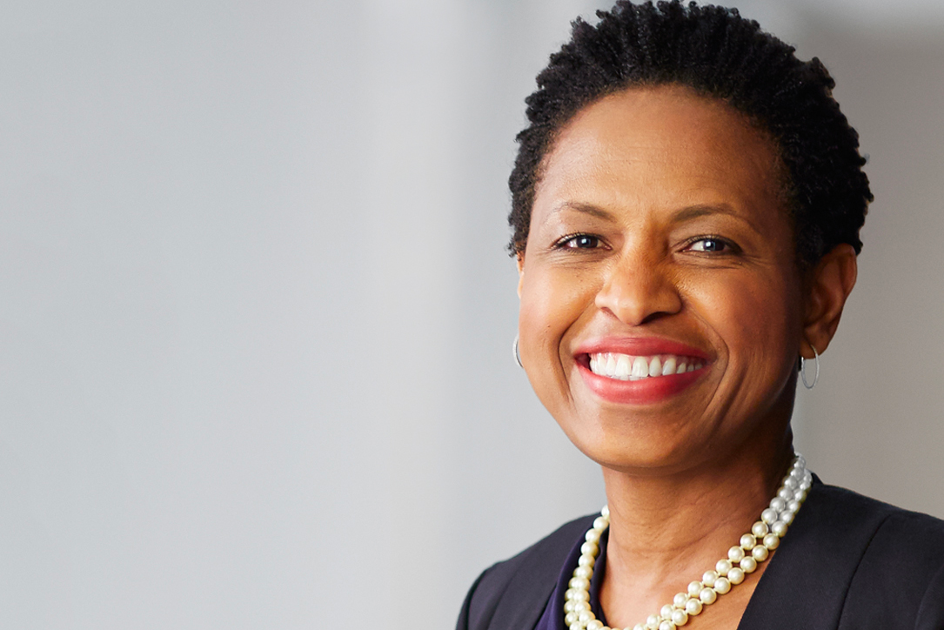





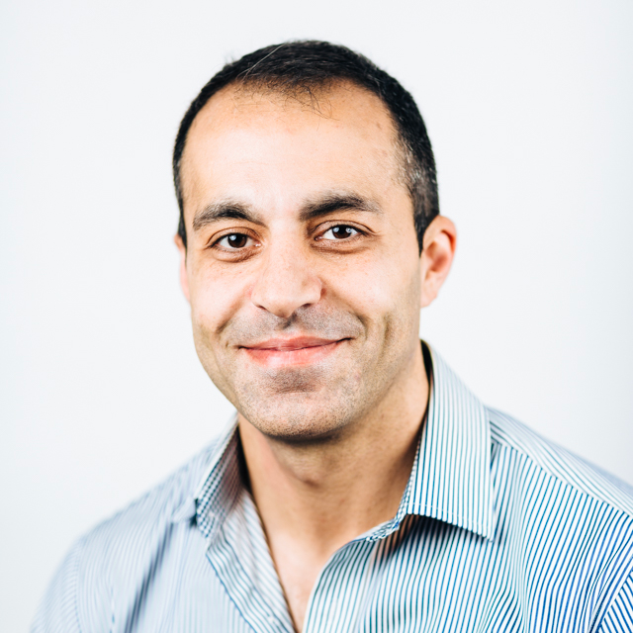
Trip Report
?
Sally – VP Ops
Likely Economic Buyer
Org Structure
Tai – Dir AI/ML
Tech Mgmt
Alaina
Data Scientist
Andy
Director Project Mgmt
Matei
Business SME
Vida
Data Engineer
Ali
Sysadmin

Slide 11
Trip Report
High-Level Goals
Improve plant efficiency ($ and time)…
… by making better use of available sensor data…
… via ML and real-time/periodic analytics
Considering Databricks for…
Scalability and performance
IoT and ML expertise

Slide 12
Trip Report
Current State and Negative Consequences
Current sensor system… Kafka-based, gathers temperatures, pressures, RPMs, etc., volume 0.5TB/day and store for 2 years, velocity approx. 30 events/sec
Data growth rate: stable
How collect/persist today: home-grown single-machine Java application, persist to mySQL (on-prem) and SQL DW (in cloud)
How analyze today? Tableau used by SQL-proficient Business Analyst team
SLAs? Today just daily/weekly/monthly/quarterly/annual
How current state falls short? Need real-time dashboards, need low-latency ML as well as large-scale analytic ML
What blockers prevent? Home-grown application not scalable, ML still conceptual – not production-worthy
What are the business consequences of these shortcomings? No real-time control of plant issues… plant costs are 5% above industry-standard benchmarks.
Are consequences related to competition, regulation, etc.? Primarily competitive b/c cannot lower costs, also regulatory re OSHA safety compliance.

Slide 13
Trip Report
Assessing MegaCorp’s ability to succeed with Databricks
Data locations: Kafka is cloud-based (Azure), mySQL is on-prem. No 3rd-party today.
Experience with Databricks? Spark? Big Data in general? IoT in general? Cloud in general? Moving to Azure (slowly), Kafka for their early IoT steps, Hadoop in other groups for customer analytics, early PayGo efforts with Databricks Azure.
Languages and tools: Java and SQL in DE, Python with PyTorch and Scikit-Learn and Pandas in DS, Tableau and SQL in Business Analytics.
Typical processes for adopting new technology? Ugh… process appears to be ad hoc and chaotic.
Bottom Line: good candidate for training and services

Slide 14
Trip Report
Compelling event and executive sponsorship
What will happen if the negative consequences you described earlier are not addressed in 1-3 quarters? Risk of falling from Premier to 2nd-tier in our competitive market
Who is ultimately accountable for addressing these issues? Sally, VP Ops
Is there a project underway now to address these issues? What is its name? What is its scope? Who is on it? What is its name? When is it due? Project AMP (Analytics and Machine Learning for Productivity), scope is plant-wide and has General Manager visibility. Core team is the people we met. Due in 6 months.

Slide 15
Trip Report
Demonstrate that Databricks can be a Trusted Advisor
AE is setting up reference call with WhiteGate
Marketing materials have convinced them of our expertise in Big Data and IoT
Take-aways for Databricks
Architecture diagrams
Suggest additional data sources for enrichment
Suggest Databricks demos and workshops
Overall Recommendation:
- This account is worth pursuing because they have an important problem we can solve… but they will need a lot of hand-holding.

Slide 16
Agenda
Discovery Questions
Trip Report
As-Is and To-Be Architecture Diagrams
Suggested Enrichment Data
RACI Chart

Slide 17
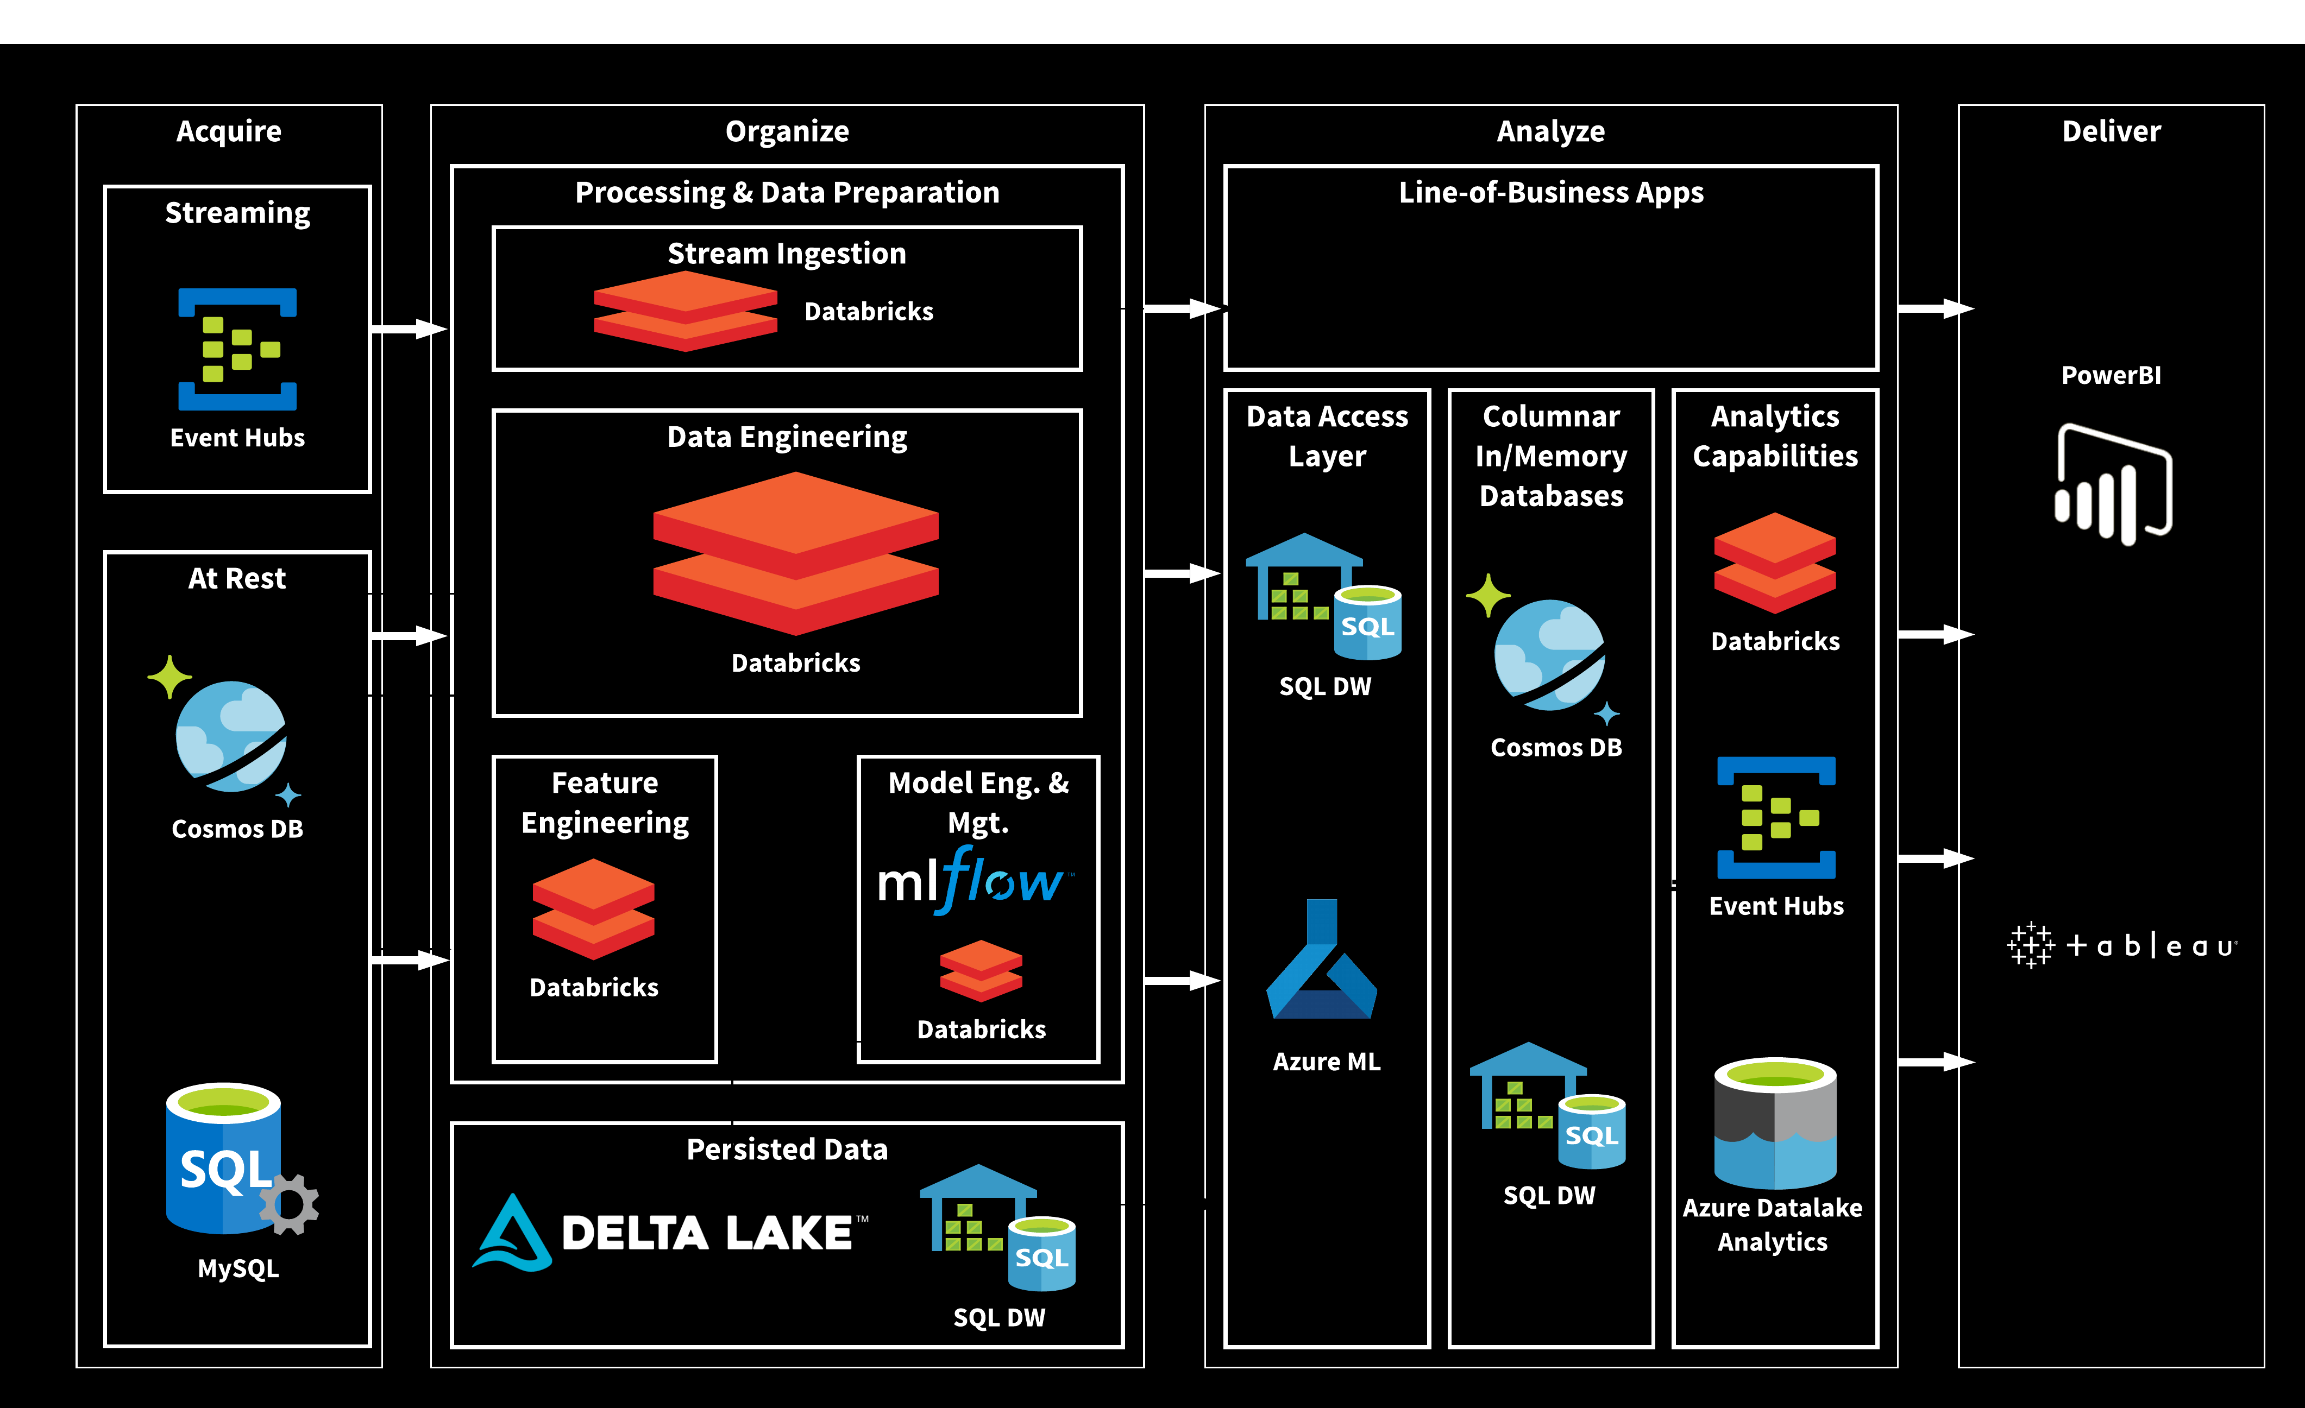




As-Is Architecture
AD HOC
Enrichment Data (TBD)
AD HOC
AD HOC
AD HOC
AD HOC
Notes:
Event hubs is Azure Kafka
Note all the ad hoc pieces. These are home-grown artifacts that represent high risk.

Slide 18

To-Be Architecture
Databricks will work with you to incorporate this data
Notes:
Event hubs is Azure Kafka
Notice that Databricks replaces the ad hoc pieces.

Slide 19
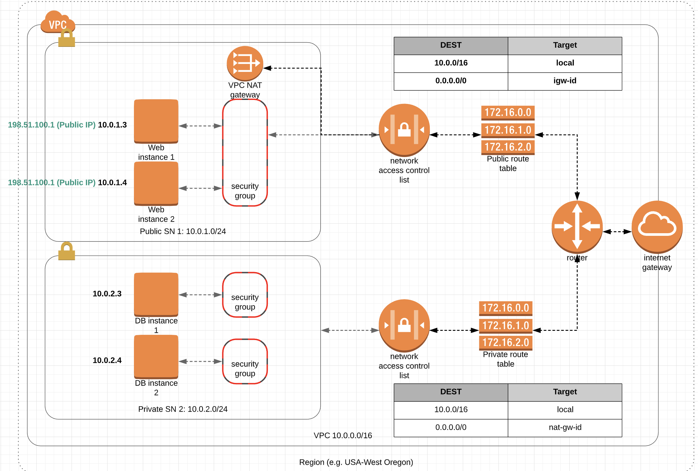
To-Be Architecture (Network/Security Overlay)
Notes:
Event hubs is Azure Kafka
Notice that Databricks replaces the ad hoc pieces.

Slide 20
Agenda
Discovery Questions
Trip Report
As-Is and To-Be Architecture Diagrams
Suggested Enrichment Data
RACI Chart

Slide 21
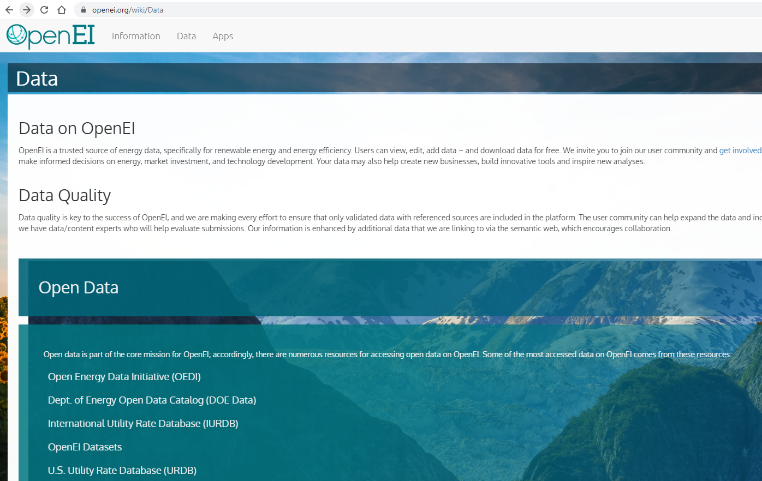
To-Be Architecture
Notes:
OpenEI provides a wide range of data sources that are valuable for Utility companies. Databricks will work with you to incorporate this data. We position ourselves as a trusted advisor.

Slide 22
Agenda
Discovery Questions
Trip Report
As-Is and To-Be Architecture Diagrams
Suggested Enrichment Data
RACI Chart

Slide 23
RACI
Responsible, Accountable, Consult, Inform
Role
Brainstorming
Story Definition
Iteration
Productionize
VP Ops (Sally)
A
A
Director AI/ML (Tai)
R
A
I
Director Project Mgmt (Andy)
C
R
A
I
Data Engineer (Vida)
C
C
R
C
Data Scientist (Alaina)
C
C
R
C
SysAdmin (Ali)
I
C
C
R
SME (Matei)
R
R
I
I
Notes:
Always have 1 person accountable, and 1 or more Responsible. Consult and inform widely to ensure success and adoption.

Slide 24
Questions and Discussion
Databricks will work with you to incorporate this data

